Slide 1

Principal Component Analysis!

Slide 2
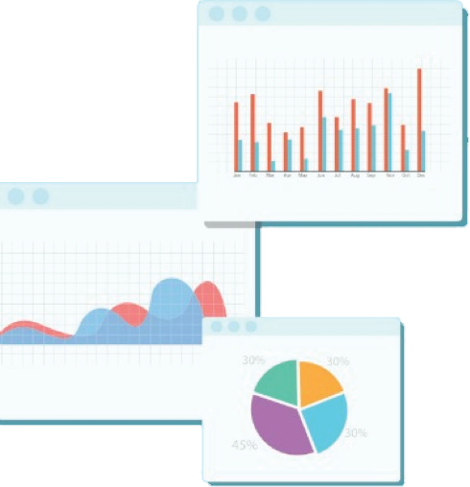


Welcome to Week 10
Lecture 1!
Data Science in Python &
Machine Learning

Slide 3
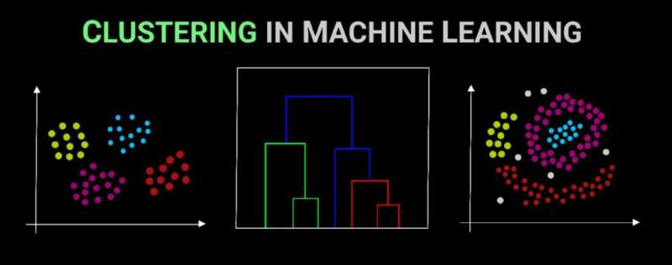
Last Week: Clustering
Image Source
Clustering groups similar samples together.
An unsupervised model defines What ‘similar’ means!

Slide 4
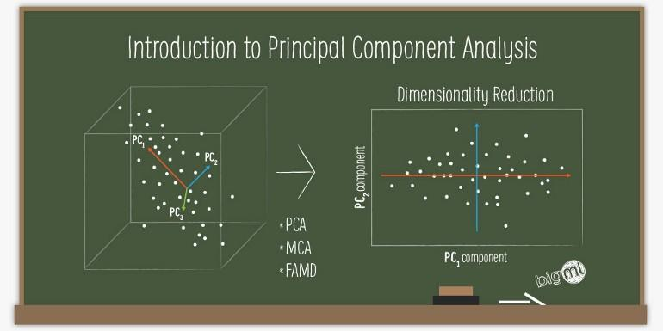
Learning Objectives
List the pros and cons of dimensionality reduction.
Explain how principal component analysis reduces the dimensionality of data while retaining maximum information.
Apply PCA to reduce the dimensionality of a set of features to prepare them for supervised learning without leaking data.
Image courtesy of Mthanraj Sharma

Slide 5
Types of Unsupervised Learning
Clustering | Dimensionality Reduction
Groups Data Together | Combines and Changes Features
Analysis | Reduces Number of Features
Feature Extraction | Feature Engineering

Slide 6

Feature Engineering:
Make new features from old features
Transform features
Combine features
Improve model’s ability to make predictions.
Photo by Christopher Burns on Unsplash

Slide 7
Why Dimensionality Reduction?
Dimensions are features (columns in the dataset)
Machine learning datasets can have a huge number of features (even in the millions!)
Too many features slow training and/or predicting
Certain algorithm training or predicting times are especially sensitive to more features
“Curse of Dimensionality”
Clustering algorithms tend to perform worse with more features: data points are more ‘spread out’
Greater risk of overfitting.
More features mean more complexity
Dimensionality reduction can be regularization by reducing complexity

Slide 8
Why Dimensionality Reduction Quiz

Slide 9
PCA Transforms or Engineers Data
Principal Component Analysis is used as a transformer
Preprocessing

Slide 10
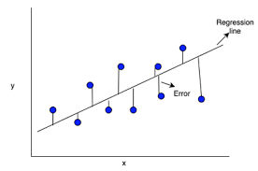
Principal Component Analysis
Reduces dimensionality by combining all features into new features called Principal Components
PCs are combinations of original features, not the original features
Errors are minimized perpendicular to the line.
PCA Errors = Information lost
PCA
Minimize errors perpendicular to the principal component
Linear Regression
Minimize errors on y-axis
Image Source
Image Source

Slide 11
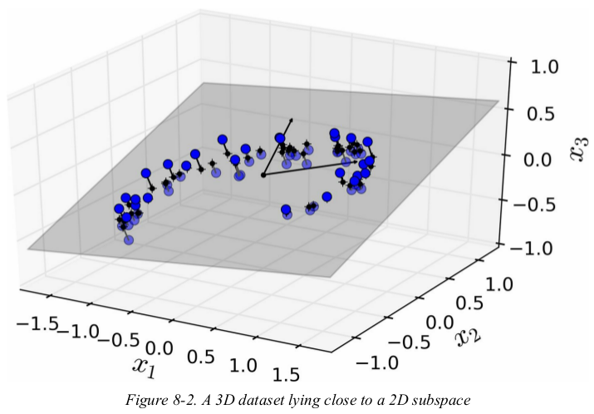
Visualizing dimensionality reduction
NOT just dropping columns
Example
This dataset is on a 3d plane (it has 3 features or dimensions)
Data is usually NOT spread out evenly across all dimensions
2d plane captures most of the variance in the data
Now, we can “pull out” that 2d plane and that becomes a 2d graph!
Source: Hand-On Machine Learning with Scikit-Learn, Keras & Tensorflow by Aurelien Geron

Slide 12
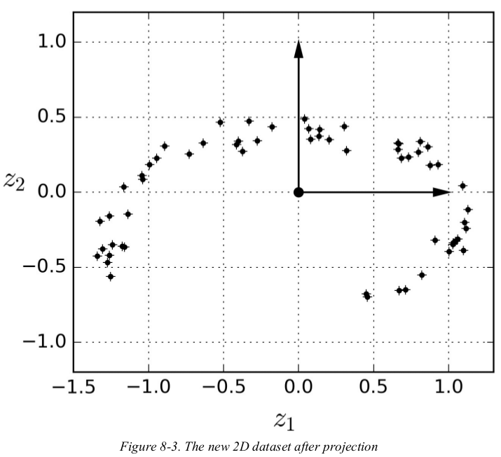
3 dimensions becomes 2 dimensions
This method is called projection.
We now have decreased from 3 to 2 dimensions.
Note: We have completely lost interpretability of the dimensions

Slide 13
How Are Principal Components Defined?
Each new component is defined as a combination of the original features, for example:
If we are reducing a dataset with 3 features, X1, X2, and X3
Into a new dataset with 2 features (principal components), Z1 and Z2,
The new components might be defined as:
Z1 = (X1 * 0.7) + (X2 * 1.3) + (X3 * -0.9)
Z2 = (X1 * 1.2) + (X2 * 1.5) + (X3 * -0.2)
For each of the 3 features of each data point in the original dataset we would use the above formulae to convert them to the 2 features of the new dataset.
PCA Step by Step

Slide 14
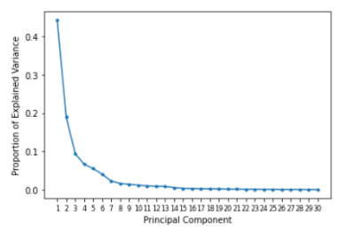
Dimensionality Reduction
Principal Components are ordered, most explained variance to least.
Reduce dimensionality with minimal information loss by removing later PCs

Slide 15
Principal Component Analysis Review
Resulting features are called ‘Principal Components’
Some information is always lost if you drop any principal components
Principal components are NOT interpretable.
Components are ordered, each explains more variance than the next.
Sign_Lang_images

Slide 16
Pros and Cons of PCA
Pros:
It speeds up training for huge datasets
Reduces “curse of dimensionality”
Can reduce overfitting
It allows us to visualize higher dimensional data on a 2d or 3d plot
Cons:
Lose information (variance)
Lose interpretability
Transformation is computationally expensive

Slide 17
Breakout Discussion: 3 minutes
In your own words, how does PCA reduce the dimensionality of the data while losing minimal information?
Choose a reporter that will report the group’s discussion.

Slide 18
PCA in Python
Import PCA
from sklearn.decomposition import PCA
Instantiate PCA
To return 20 components:
pca = PCA(n_components=20)
To capture 50% of variance:
pca = PCA(n_components=0.5)

Slide 19
PCA as a Transformer in a Model Pipeline
Do other preprocessing: OHE, Ordinal Encoding, Scaling, Imputing, etc
BEFORE PCA,
Then PCA transform ALL features.
knn_pipe = make_pipeline(preprocessor, pca, model)
knn_pipe.fit(X_train, y_train)

Slide 20

Today’s Challenge
Today’s Data: Identify defects in motors
“Column 49” is the target, note that 1 is the normal condition, and the others are various types of defects
Goal: Predict the condition of the motor with the highest overall accuracy
This dataset is a great candidate for PCA because it has a lot of features
Also the prediction task is not focused on interpreting the features: We just need to identify what type of defect it is.
Challenge Notebook
Click on :
Original Source of Data

Slide 21
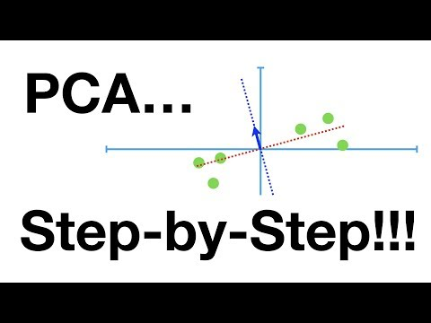
More Information:
Check out this awesome video by StatQuest!

Slide 22
Assignments This Week:
PCA Exercise:
MNIST dataset: Image classification!
2 different ways to load the dataset are shown in assignment
Option 1: fetch_openml
mnist.data = features
mnist.target = target
Option 2: keras.datasets.mnist
Comes already split
Must be reshaped for traditional ML (See code)

Slide 23
Assignments This Week (cont):
Feature Engineering Exercise
Be sure to carefully read ALL directions!
Please use a Lambda function to convert temperatures
Double check your conversion formula: are the results sensible? Would many people likely go bike riding in 104 degree heat?

Slide 24
Assignments This Week (cont):
Project 2 Part 4
This is big assignment! Set aside plenty of time!
You are finishing your project
PCA
Model development
Finishing touches (code comments, clean code, section headings, professional quality ‘final draft’ notebook)
1 notebook with all parts
Or 2 notebooks: analysis and modeling
Don’t name sections ‘part 1, part 2, etc’
README: Final draft! Visually appealing with proper, readable, English.
If writing in English is not a strength, ask someone to read it over for you for grammar and clarity.
Employers will judge you on your ability to communicate about analysis and modeling!

Slide 25
Study Next: Feature Engineering
To prepare for next lecture:
Please Read:
Feature Engineering: Overloaded Operators
Feature Engineering: Strings
Feature Engineering: Datetime
Feature Engineering: Functions
Daily Schedule

